Slide 1
SMART WATER QUALITY MONITORING SYSTEM
Project Work done in partial fulfilment of the requirement for the degree of
FACULTY OF ENGINEERING &TECHNOLOGY
FIRST YEAR
Students Name
College Details
FEB 2025

Slide 2

ABSTRACT
The Smart Water Monitoring System is an innovative solution designed to monitor and manage water quality by measuring crucial parameters such as pH and temperature.
This system uses advanced sensors connected to an ESP8266 microcontroller, which transmits real-time data to the Blynk IoT platform.
The data is then accessible via a user-friendly mobile or web interface, enabling efficient monitoring of water quality.
By leveraging the power of IoT, this system provides valuable insights into water conditions, supporting applications in agriculture, water treatment, and environmental monitoring.
The system is designed for ease of use, accuracy, and reliability, ensuring that water quality can be efficiently managed and tracked remotely.
1

Slide 3
OVERVIEW
Introduction
Objectives
Literature Survey
Existing System
Proposed System
Block Diagram
Components
Application
Conclusion
Reference’s
2

Slide 4
INTRODUCTION
Water quality monitoring is essential for ensuring the safety and sustainability of water resources. Traditional methods of water testing can be time-consuming, labor-intensive, and often limited to periodic measurements.
With the advancements in Internet of Things (IoT) technology, real-time monitoring of water quality has become more efficient and accessible. This Smart Water Monitoring System leverages modern sensors to measure key water parameters like pH and temperature, providing continuous, real-time data.
The system is based on an ESP8266 microcontroller that sends the data to the Blynk IoT platform, where users can remotely access and monitor the water quality. By enabling instant access to water condition data, this system helps in timely decision-making for industries, agriculture, and environmental conservation.
3

Slide 5
OBJECTIVES
The Smart Water Monitoring System aims to provide real-time monitoring of water quality using pH and temperature sensors, integrated with the ESP8266 microcontroller.
The system transmits data to the Blynk IoT platform, enabling users to remotely access and visualize water parameters through a mobile or web application.
This approach ensures accurate, reliable, and continuous monitoring, allowing for timely intervention when water quality issues arise.
By utilizing IoT technology, the system offers an efficient and scalable solution for various applications, including environmental monitoring and agriculture.
4

Slide 6
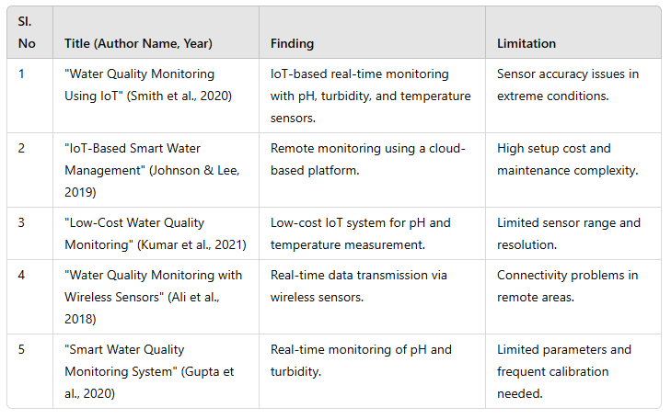
LITERATURE SURVEY
TITLE OF THE PAPER WITH AUTHOR NAME
JOURNAL NAME/YEAR OF PUBLICATION
FINDINGS
LIMITATIONS
5

Slide 7
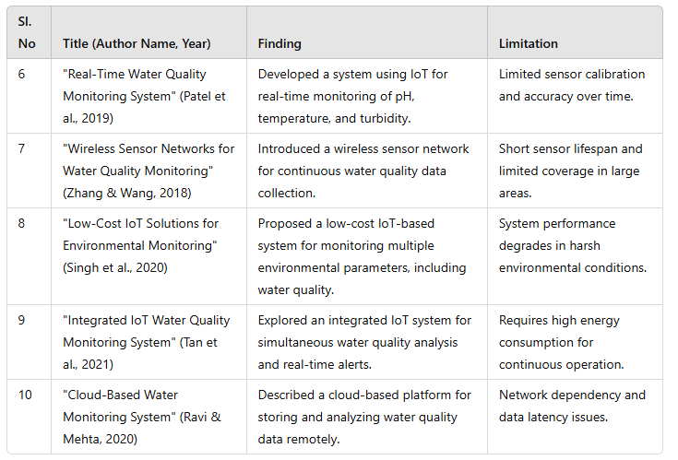
LITERATURE SURVEY
LIMITATIONS
6

Slide 8
EXISTING SYSTEM
Current water quality monitoring systems typically rely on manual testing or local sensors that provide limited data access. These systems are often bulky, expensive, and not easily scalable for continuous monitoring.
Traditional methods involve taking water samples and sending them to laboratories for analysis, which can be time-consuming and may not provide real-time results. Some automated systems exist, but many are standalone devices that require manual intervention for data collection and analysis.
Furthermore, remote monitoring is not always available, making it difficult for users to track water quality in real-time, especially in remote or hard-to-reach locations.
7

Slide 9
PROPOSED SYSTEM
The proposed Smart Water Monitoring System aims to address the limitations of existing systems by utilizing IoT technology for continuous, real-time water quality monitoring.
By integrating pH and temperature sensors with an ESP8266 microcontroller, the system collects data and transmits it to the Blynk IoT platform.
This cloud-based solution allows users to remotely monitor water quality through a mobile or web application, ensuring accessibility and real-time updates.
The system is designed to be cost-effective, scalable, and easy to use, providing an efficient solution for water quality management in various sectors, including agriculture, industry, and environmental conservation.
8

Slide 10
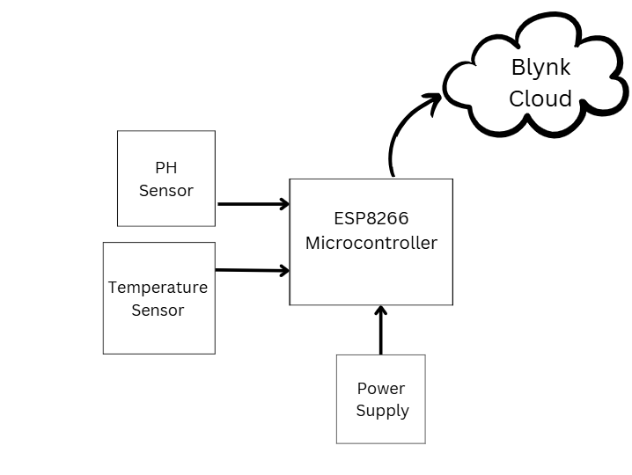
BLOCK DIAGRAM
9

Slide 11
COMPONENTS
1. ESP8266 Microcontroller:
The ESP8266 is a low-cost WiFi microcontroller used for wireless communication in IoT applications. It handles data acquisition from sensors and sends the data to the Blynk IoT platform.
2. pH Sensor:
The pH sensor measures the acidity or alkalinity of water, providing essential data for monitoring water quality. It works by detecting the hydrogen ion concentration in the water sample.
3. Temperature Sensor:
The temperature sensor measures the water's temperature, which is crucial for evaluating its quality and suitability for various applications. It provides accurate and real-time temperature readings.
4. Blynk IoT Platform:
The Blynk IoT platform enables remote monitoring and control of the system through a mobile or web application. It collects data from the ESP8266 and visualizes it in a user-friendly interface for real-time access.
5. Power Supply:
A stable power supply is required to power the ESP8266 microcontroller and sensors. It ensures that the system operates reliably without interruptions, especially for remote monitoring.
10

Slide 12
FEATURES
The Smart Water Monitoring System offers several key features that make it an effective solution for real-time water quality monitoring. It allows for continuous tracking of critical parameters such as pH and temperature, providing real-time data on water quality.
The system integrates seamlessly with the Blynk IoT platform, allowing users to access the data remotely via mobile or web applications. The cloud-based design ensures that data is stored and can be easily accessed anytime, anywhere, making monitoring efficient and convenient.
Additionally, the system is cost-effective, scalable, and equipped with a user-friendly interface for easy operation and analysis, making it suitable for a wide range of applications.
11

Slide 13
APPLICATION
The Smart Water Monitoring System can be applied across various industries where water quality is a critical factor.
In agriculture, it helps farmers monitor irrigation water to ensure the optimal health of crops.
Environmental monitoring is another important application, allowing the system to track the quality of rivers, lakes, and other water bodies, ensuring they remain safe for ecosystems and human use.
Water treatment plants benefit from continuous monitoring, ensuring that water quality meets regulatory standards before it is distributed.
In industrial applications, the system can be used to monitor water conditions in manufacturing processes, cooling systems, or other water-dependent operations.
12

Slide 14
CONCLUSION
The Smart Water Monitoring System demonstrates the significant potential of IoT technology to improve water quality management. By integrating pH and temperature sensors with the ESP8266 microcontroller and leveraging cloud-based platforms like Blynk IoT, the system provides a reliable, real-time monitoring solution that is both efficient and accessible. Its low cost, scalability, and user-friendly interface make it suitable for various sectors, including agriculture, environmental monitoring, water treatment, and industrial applications. This project not only highlights the capabilities of IoT in addressing modern water quality challenges but also sets the stage for future advancements in the field, enabling better water resource management for a sustainable future.
13

Slide 15
REFERENCE’S
ChoZinMyint, Lenin Gopal and Yan Lin Aung,”Reconfigurable smart water quality monitoring system in iot environment”, IEEE Internatinal Conference on Information Systems(ICIS),978-1-5090-5507-4/17,May 2017.
Sona Pawara, Siddhi Nalam, Saurabh Mirajkar,Shruti GujarVaishali Nagmoti,” Remote Monitoring of Waters Quality from Reservoirs”, 2017 2nd International Conference for Convergence in Technology (I2CT).
Francesco A, Fliippo A, Carlo G C ,Anna M L,”A Smart sensor network for sea water quality monitoring, IEEE Sensors J 15(5):2514-2522,May 2015.
S. P. Gorde, M. V. Jadhav “Assessment of Water Quality Parameters: A Review”, S. P. Gorde et al Int. Journal of Engineering Research and Applications ,ISSN : 2248-9622, Vol. 3, Issue 6, Nov-Dec 2013, pp.2029-2035.
S. Geetha and S. Gouthami,” Internet of things enabled real time water quality monitoring system”, Springer open (2017) 2:1 DOI 10.1186/s40713-017-0005-y.
14

Slide 16
REFERENCE’S
AainaVenkateshwaran, HarshaMendha, Prof. PritiBadar,“An IoT based system for water quality monitoring”,International Journal of Innovation Research in Computer and Communication Engineering,Vol.5, Issue 4,April 2017.
VaishanviVDaigavane,Dr. M A Gaikwad,”Water quality monitoring system based on IoT”,Advances in wireless and mobile communications,ISSN 0973-6972 Volume 10,Number 5,2017,pp. 1107-1116.
Aravinda S. Rao, Stephen Martial, JayavardhanaGubbi, MarimuthuPalani Swami, “Design of low-cost autonomous water quality monitoring system”, 2013 IEEE, pp. 14-19.
Cheng-Liang Lai, Chien-Lun Chiu “Using image processing technology for water quality monitoring system”,July2011 IEEE, pp. 1856-1861.
Niel Andre Cleote, Reza Malekian and Lakshmi Nair,” Design of smart sensors for real-time water quality monitoring,”,vol 13, no. 9, September 2014 IEEE, pp 1-16.
15

Slide 17
THANK YOU

